Slide 1
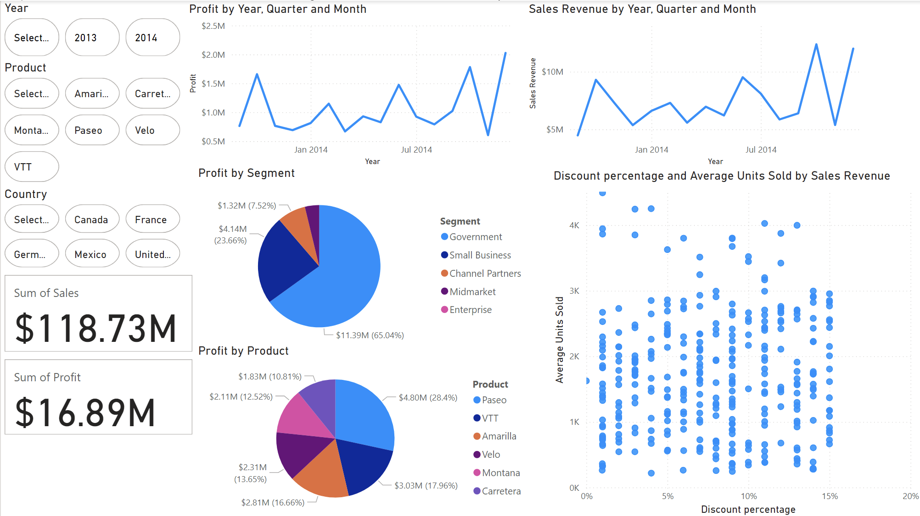
Power BI Project
Nathan Weir

Slide 2
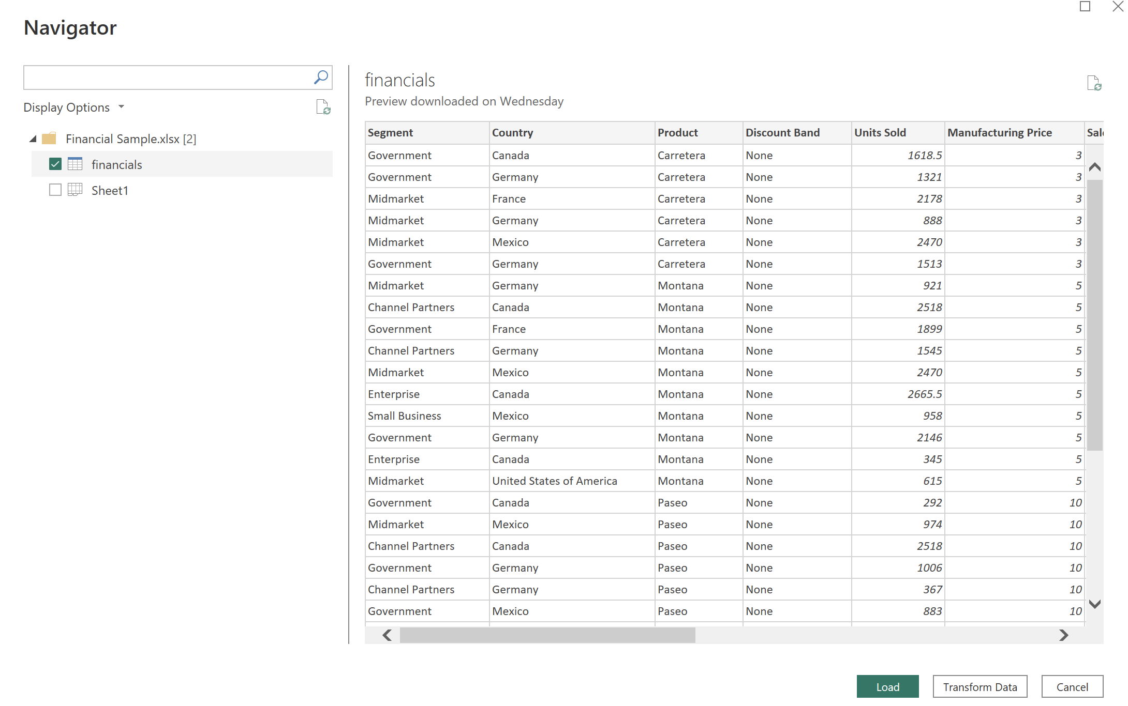
The Dataset
The ‘financial’ dataset used for this project was taken from the PowerBI sample databases
It is comprised of sample financial data from a global business.

Slide 3
Objectives
Business questions:
What are the total sales and profit trends over the years?
Which product or segment is generating the most profit?
How have discounts impacted the overall sales?
Which month has the highest sales performance?
During the project I aimed to answer these questions by creating a user-friendly interactive dashboard, consisting of a combination of visuals and slicers to allow in-depth analysis of this dataset.

Slide 4
ETL Process
Once the data was loaded into Power BI I selected ‘transform data’ to access Power Query, this is the tool I used to clean the data.
The next step was the clean the data in Power Query, to do this I need to look at the business questions to establish what data is required to create the necessary visuals.
I then removed unnecessary columns such as month number, month name and year. I also created a new column for discount as a percentage of the standard price of each product by using the formula: Discount percentage = DIVIDE(financials[Discounts], financials[Gross Sales]).
I then removed duplicate rows and missing values from the dataset.
The next step was to assign each column the correct data type.
I used trim and clean to get rid of any spaces and non-printable characters.
Finally, I closed and loaded this data back into Power BI to create visuals.

Slide 5
Dashboard Overview
This dashboard consists of the following visuals:
A line graph displaying sales data
A line graph showing profit data.
A pie chart showing the proportion of profit for each segment
A pie chart showing the proportion of profit for each product
A table and a scatter chart to show how units sold and sales revenue are affected by discount percentage for products
A card to show total sales revenue
A card to show total profit
A card to show total profit margin
A slicer for product
A slicer for country
A slicer for year

Slide 6
Total sales: $118.73M
Total units sold: 1,125,806
Government is the segment generating the highest profit; with 65% of all profits coming through this segment, this equates to $11.39M.
October (2014) is the month with the highest sales performance, generating $12.4M in sales revenue.

Slide 7
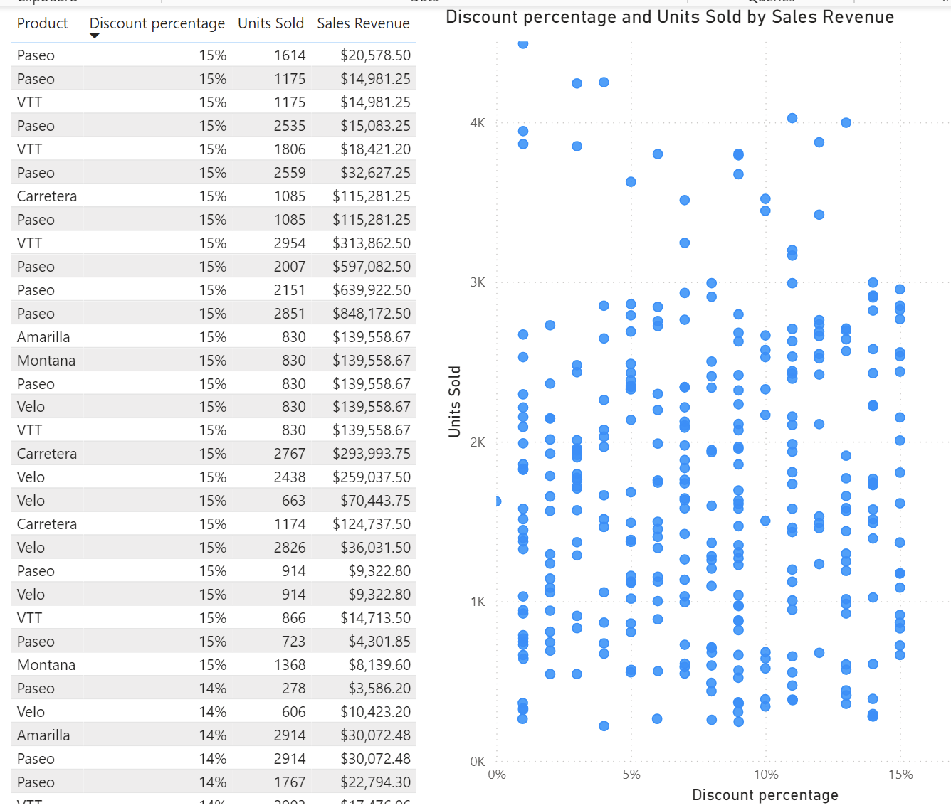
Discounts
As seen in the table and scatter chart there is no relationship between discount percentage and sales revenue or units sold.
Therefore, this business should only give out discounts as a last resort option to get rid of stock as they are not enhancing units sold or sales revenue.

Slide 8
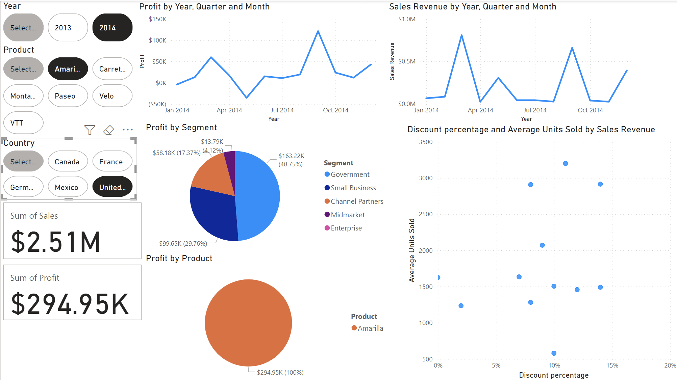
This screenshot demonstrates the interactivity of this dashboard.
Businesses could use a dashboard like this to compare performance in a specific year or country for a specific product.
For example, based on this data, the business could look to at marketing more towards government in the USA. This is because 48% of profit is from government in the USA but it is 65% when looking at the data from all countries.

Slide 9
Conclusion
Aside from the dramatic drop-off in November, it appears that this business’s sales performance has improved from August to December 2014. Which is positive and shows that this business is on a good path towards continued success.
Moving forward, this business could potentially increase its prices, find new more profitable products to sell and reduce its costs as its overall profit margin is just 7% which is fairly low. A global business producing this much revenue over 15 months should aim for profit margins above 10%.
Overall, this dashboard can be used by businesses to take a deep dive into their financial data and gain insights into how and/or where they can improve their sales revenue and profits.

